Slide 1
A Primer For
Licensing To Corporations
(A Peek Under the Corporate Tent)
Presentation for:
February, 2012
Inventors Association
Of Connecticut

Slide 2
BUSINESS DEVELOPMENT RESOURCES, INC.
Founded in 1983
Marketing Consultancy
Specializing in:
    New Business Development
    New Product Development
    Innovation
Client Roster
    Corporations
    Small/mid-size Firms
    Inventors & Entrepreneurs

Slide 3
BUSINESS DEVELOPMENT RESOURCES, INC.
We believe the answer to the innovation puzzle is a function of blending technology with creative marketing
Strategic Growth Opportunity Identification
& Development
Technology
Development
Tech-KnowledgySM Search
Toys In The Attic
Technology Leveraging
Packaging Strategy
On-Line Brainstorming
Vision Creation
New Businesses/New Product Concept Development & Qualification
Positioning/Repositioning
Opportunity Assessments
Brand Development
Innovative
Profitable
Solutions
Strategic
Due
Diligence
Brand/ Technology
Licensing
Development
New Category/New Business Assessments
Strategic Marketing Assessments For Acquisitions/ Alliances
Brand Out-Licensing
Brand In-Licensing
Technology Out-Licensing
Technology In-Licensing

Slide 4
BUSINESS DEVELOPMENT RESOURCES, INC.
Three Key Messages:
  Sell the business proposition, merely describing your IP is not enough
  Get decision makers in the audience, get their attention, get them excited
  Make it ‘Easy To Buy”

Slide 5
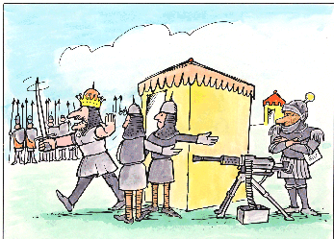
NO!! I can't be bothered to see any crazy salesman--- We've got a battle to fight!!
BDR
AMMO

Slide 6
A Primer for Licensing
To Corporations
Issue: To License or Build ?
  License:
    Lower risk ~ Mailbox money
  Build:
    Higher risk
    Value of proposition increases with incremental validation
    Gradation issue…how far to go
    Critical mass issue longer-term

Slide 7
A Primer for Licensing
To Corporations
Prototypical Process
Inventor
Agent
Initial Technology Opportunity Contact
Gatekeeper
Pre-Screening
No Interest
Interest
Confidentiality Agreement Executed
Technology Presentation
Internal Assessment
Follow-up Questions
Re-Convene
Terminate
Continue
Option Period
Due Diligence
No Go
Go
Terminate
Negotiations
Licensing Agreement

Slide 8
A Primer for Licensing
To Corporations
Issue: IP Owner Credibility
  Why should we meet?
  Go direct vs. agent

Slide 9
A Primer for Licensing
To Corporations
Issue: Does A Conflict Exist ?
  Does external opportunity infringe on R&D activities?
  If so, to what extent?
  How to protect Company interest?

Slide 10
A Primer for Licensing
To Corporations
Issue: How Does it Fit
our Business?
  Product improvement?
  Line extension?
  Entry strategy to new business?
    Product improvement & line extension easier to assess
    New business more difficult to evaluate

Slide 11
A Primer for Licensing
To Corporations
Does it Solve an
Existing Problem?
Issue:
  Among consumers or customers?
  If so, to what extent?
  What validation exists for support
  Little or no homework done typically !!

Slide 12
A Primer for Licensing
To Corporations
Issue: How Feasible Is It ?
  Many don’t really understand prospect’s business
  Stage of development…difficult to deal with early stage technology
  Can it be reduced to practice?
  Can it be scaled-up efficiently?

Slide 13
A Primer for Licensing
To Corporations
Issue: What Claims are Available?
  Have they been substantiated?
    If so, how and to what extent?

Slide 14
A Primer for Licensing
To Corporations
Issue: IP Owner
Expectations
  Owner – ROI motives
  Prospect – Affordability
    Internal Financial Hurdles
    Commercialization Expense
  Who owns what?…development by prospect may be required
  Exclusivity considerations
  License/buy-out/joint-venture

Slide 15
A Primer for Licensing
To Corporations
Issue: Valuation
  How to value the proposition
  Hard data vs. subjective opinion
  Can make or break a deal
  The “Win-Win” equation

Slide 16
A Primer for Licensing
To Corporations
Issue: Funding
  How to fund due diligence?
    Development priorities underway…little or no discretionary funds available
    What priority should be “short-sheeted”?
  How to fund commercialization
    Development priorities in place today

Slide 17
A Primer for Licensing
To Corporations
Overall Make It Easy
Objective: to Buy!
  Validation of concept viability
    Problem(s) it solves
    Target audience
    Benefits
  Claim structure
    Substantiation is key
  Feasibility confirmation
    Protocepts/prototypes/production samples

Slide 18
A Primer for Licensing
To Corporations
Overall Make It Easy
Objective: to Buy!
  Preliminary economics
    ProForma P&L’s
  Competitive insulation
    What & how long
  Strategic fit
  Valuation
  Proposed deal
    Preliminary term sheet

Slide 19
A Primer for Licensing
To Corporations
Benefits of A Licensing Agent
Identify high potential and enduring business propositions for the IP
  Including NEW applications
Compelling, motivating presentations
Increase valuation
  Integrate elements for "turn-key”
Identify high potential licensees
Assemble decision-making audience
  CEO a key player
Negotiate the final term sheet
  Structure a 'win-win' deal for both licensor and licensee

Slide 20
A Primer for Licensing
To Corporations
Do | Don’t
Hire the best patent attorney affordable | Prematurely disclose your idea to anyone but a patent attorney
Budget for the second half of the game – marketing! | Limit yourself to the obvious licensing prospects
Make a protocept or prototype | Pit one company against another
Gather as much consumer research as possible | Be greedy Must be a win-win for all
Mandate CDA’s be signed prior to presentations | Leave any money on the table No need for rounding!
Request complete proposals from licensing agents Costs Timing Deliverables References – CHECK THEM!

Slide 21
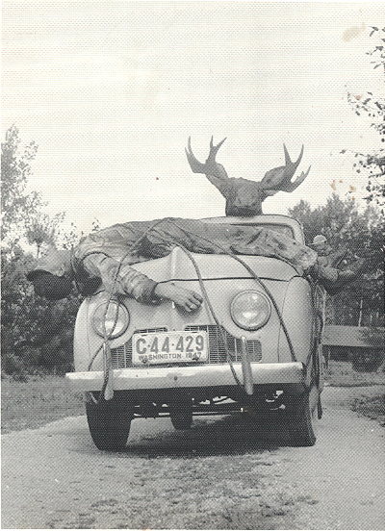
Never underestimate …
The competition.

Slide 22
THANK YOU !!
GOOD LUCK !!
HAVE FUN !!

